Slide 1
The Force is With You. A judicial perspective on Sentencing Children in Queensland
John Robertson
Chair, Queensland Sentencing Advisory Council

Slide 2
About the Council
Provide advice to the Attorney-General about sentencing matters, if asked
Give information to the community to enhance knowledge of sentencing
Publish information about sentencing
Research sentencing matters and publish the outcomes
Obtain the community’s views on sentencing
Provide its views to the Court of Appeal on the giving or reviewing of a guideline judgment, if asked
Notes:
About the Council
The Queensland Sentencing Advisory Council is an independent statutory body established under the Penalties and Sentences Act, the functions of which are set out under the Act and include to provide independent research and advice, seek public views and promotes community understanding of sentencing.
The Council provide advice only at the request of the Attorney-General.
As an advisory body, it is a matter for Government how it responds to the Council’s reports, and there is no requirement for the Queensland Government to formally respond – although the Council has been fortunate to have a number of its recommendations acted upon and implemented. In this respect, the Council is much like other law reform bodies and commissions.
But the Council has a much broader role in informing and engaging with the community through a variety of means, including our ‘Judge for Yourself’ interactive program (which we also run for schools and community groups in a face-to-face format), our Sentencing Spotlight series, which focuses on key sentencing trends – usually around a particular offence or type of offending, our research report series which looks at issues in more depth and information of a more general nature on our website. I will also mention that the Council is in the process of developing new video vignette series (working title of ‘Doing Justice Differently’) – the first of which is focused on the operation of the Qld Drug and Alcohol Court [THANK Annette Hennessy and the Chief Magistrate, Judge Terry Gardiner, for their support of the development of these videos – to be launched later in the year].
As an important point of clarification, I should also say that the Council is the Sentencing Advisory Council – not the ‘Sentence Advisory Council’ as is sometimes reported. The Council doesn’t have a role in providing advice about the sentencing of individual offenders, and nor does the Council comment on individual cases or sentencing outcomes.
The Council consists of 12 members, including my role as the Chair.
The Council’s membership is broad and includes members representing the interests of Aboriginal and Torres Strait Islander peoples (Bevan Costello – a Waka Waka man and Chair of the Barambah Justice Group and member of the Cherbourg Community Council), victim and offender advocates (Debbie Kilroy OAM – Sisters Inside, Jo Bryant – PACT), legal practitioners (in private practice (Dan Rogers – Principal, Robertson O’Gorman and Kathleen Payne – a barrister specialising in criminal law, domestic and family violence and institutional child sexual and other abuse), working for community legal centres (Warren Strange – CEO of Know more – a national CLC assisting survivors of child abuse with redress and justice options), and engaged by Legal Aid Queensland and the Office of the Director of Public Prosecutions (Katarina Prskalo – Acting Deputy Public Defender and Philip McCathy – Consultant Crown Prosecutor), senior law enforcement officers (Det Chief Superintendent Cheryl Scanlon, Executive Director, Operations Support, Crime and Corruption Commission), academics (namely Professor Elena Marchetti, who would be known to many of you here, and is also the Council’s Deputy Chair), and members with a background in psychology and criminology (Helen Watkins). A number of our Council members also have at various times been members of a Parole Board (Helen, Kathleen and John).
The Council is assisted in its functions by an Aboriginal and Torres Strait Islander Advisory Panel comprised of up to 8 independent members (currently 7 members due to resignation of Melissa Lucashenko) who provide expert advice to QSAC as it works to understand and address the over-representation of Aboriginal and Torres Strait Islander people in Queensland’s criminal justice system.
The Council has a small Secretariat (11 staff in total), led by Anne Edwards as the Director, broadly organised into a Policy, Research and Statistics and Community Engagement Team.

Slide 3
Sentencing of children: Legal framework
The sentencing of children in Queensland is governed by the Youth Justice Act 1992
The sentencing regime that applies to children is very different to that which applies to adults under the Penalties and Sentences Act 1992
The Act confers jurisdiction on the Childrens Court to hear and decide criminal charges involving children, excluding Supreme Court offences
It also sets out the types of sentencing orders that can be imposed and maximum periods of detention that can be ordered
Notes:
Additional information
Charter of Youth Justice Principles
For those familiar with the Youth Justice Principles, there is legislation currently being considered by the Legal Affairs and Safety Parliamentary Committee (the Youth Justice and Other Legislation Amendment Bill 2021) that, if passed, will amend Principle 1 – that the community should be protected from offences — to insert the words ‘and, in particular, high-risk recidivist offenders’.
Among other reforms, that Bill also proposes to amend section 150 of the Act to codify a requirement to take into account the presence of any aggravating or mitigating factor concerning the child, including whether the child committed the offence while released into the custody of a parent, or at large with or without bail, for another offence, or after being committed for trial or awaiting trial or sentence for another offence.
The Committee has held public hearings around the State on this and other proposed changes and is due to report to Parliament on 16 April 2021. https://www.parliament.qld.gov.au/work-of-committees/committees/LASC/inquiries/current-inquiries/YJandOLAB2021
Special considerations (YJA, s 150(2))
Special considerations are that:
(a) a child’s age is a mitigating factor in determining whether or not to impose a penalty, and the nature of a penalty imposed; and
(b) a non-custodial order is better than detention in promoting a child’s ability to reintegrate into the community; and
(c) the rehabilitation of a child found guilty of an offence is greatly assisted by—
(i) the child’s family; and
(ii) opportunities to engage in educational programs and employment; and
(d) a child who has no apparent family support, or opportunities to engage in educational programs and employment, should not receive a more severe sentence because of the lack of support or opportunity; and
(e) a detention order should be imposed only as a last resort and for the shortest appropriate period.
Other factors (YJA, s 150(1))
In sentencing a child for an offence, a court must have regard to—
…
(d) the nature and seriousness of the offence; and
(e) the child’s previous offending history; and
(f) any information about the child, including a pre-sentence report, provided to assist the court in making a determination; and
(g) if the child is an Aboriginal or Torres Strait Islander person—any submissions made by a representative of the community justice group in the child’s community that are relevant to sentencing the child, including, for
example—
(i) the child’s relationship to the child’s community; or
(ii) any cultural considerations; or
(iii) any considerations relating to programs and services established for offenders in which the community justice group participates; and
(h) any impact of the offence on a victim, including harm mentioned in information relating to the victim given to the court under the Victims of Crime Assistance Act 2009, section 15; and
(i) a sentence imposed on the child that has not been completed; and
(j) a sentence that the child is liable to have imposed because of the revocation of any order under this Act for the breach of conditions by the child; and
(k) the fitting proportion between the sentence and the offence.
Additional information
Queensland Courts have developed a Youth Justice Benchbook intended to be a comprehensive guide for judges and magistrates sitting in the criminal jurisdiction of the Childrens Court of Queensland
The Council is currently working on a sentencing guide on the sentencing of children aimed at the general community based on content drawn (with permission) from the Benchbook. We hope to release this resource later this year.

Slide 4
Rates of offending in Australia: Highest for 15-19 year-olds
Offender rate by age group, 2018-19
Most children do not continue to offend
A Queensland-based cohort study (Livingston et al, 2008) identified 11% of offenders as chronic offenders (starting in childhood)
This group is responsible for one-third of all offences committed
Source: Australian Bureau of Statistics, Recorded Crime – Offenders, Table ‘Offender rate(a) by age group(years), 2018–19 to 2019–20’.
Notes:
Data published by the Australian Bureau of Statistics on offender rate by age group in 2018-19 shows that the rate of offenders rises sharply from late childhood, peaks in late adolescence then slowly declines from early adulthood.
Despite this, it had been consistently observed that only a small proportion of these young people will go on to commit more offences as they grow older. Research shows that most children and young people ‘grow out’ of offending.
An increasing number of studies on juvenile offending are using concepts from developmental and life-course criminology to study criminal trajectories of children and young people. A Queensland-based study found that there is a small number who are categorised as chronic offenders (11% of all offenders) who engage in persistent offending that starts in childhood and continues into adulthood. This group is responsible for one-third of all offences committed.
Source: Michael Livingston, Anna Stewart, Troy Allard and James Ogilvie, ‘Understanding juvenile offending trajectories’ 41(3) December 2008, Australian and New Zealand Journal of Criminology

Slide 5
Sentencing of children: Common offences (2019/20)
Magistrate court
54.7% involve theft offences
28.8% involve unlawful entry
26.7 % involve public order offences
Higher courts
33.4% involve theft offences
25.7% involve acts intended to cause injury
59.3% involve robbery
Notes:
Most common offences children are sentenced for in Queensland (2019/20)
Please see our breakdown of sentencing trends on our website for more information
A few notes on data (just for information):
Offenders are often sentenced for multiple offences, and receive multiple penalties, at a single sentencing event. As a result, the % of total cases may be higher than expected, and will result in totals greater than 100%.
Data includes people who received at least one juvenile penalty at a sentencing event – if a person received a mix of both adult and child penalties, they were considered to be a child.

Slide 6
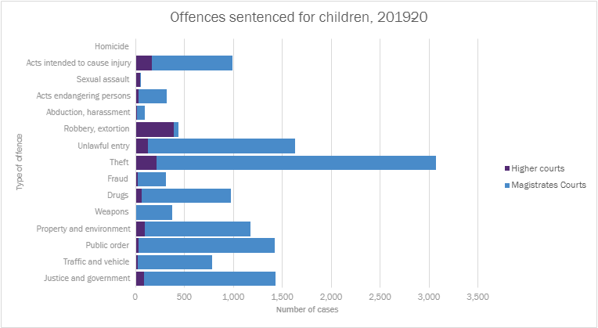
Sentencing of children: Offences sentenced (2019/20)

Slide 7
Sentencing of children: Common penalties (2019/20)
Magistrate court
28.9% court-ordered conference
18.4% probation
39.2% reprimand
Higher courts
63.9% probation
21.7% court-ordered conference
15.9 % detention
Notes:
Common penalties for children in Queensland (2019/20)
Please see our breakdown of sentencing trends on our website for more information
A few notes on data (just for information)::
Offenders are often sentenced for multiple offences, and receive multiple penalties, at a single sentencing event. As a result, the % of total cases may be higher than expected, and will result in totals greater than 100%.
Data includes people who received at least one juvenile penalty at a sentencing event – if a person received a mix of both adult and child penalties, they were considered to be a child.

Slide 8
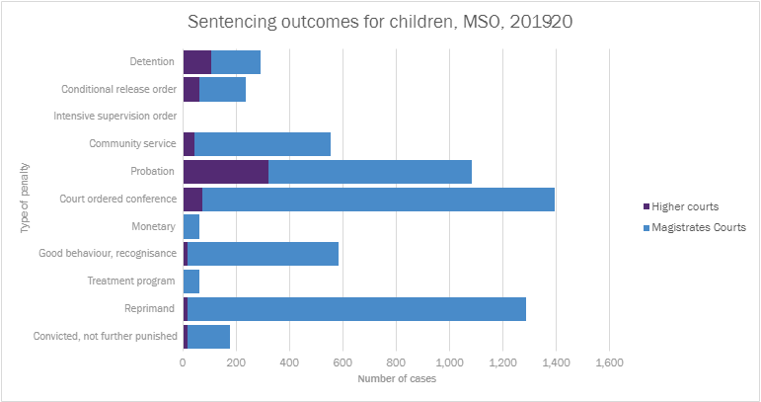
Sentencing of children: Sentencing outcomes (2019/20)

Slide 9
Overrepresentation of Aboriginal and Torres Strait Islander children in detention
The proportion of cases sentenced in court involving Aboriginal and Torres Strait Islander children (12.7%) is more than double that of non-Indigenous children (4.7%)
Aboriginal and Torres Strait Islander children being admitted to youth detention centres is higher compared to non-Indigenous children
In 2018–19, Aboriginal and Torres Strait Islander children comprised 68.0 % of those admitted to detention (Justice report, Queensland Government Statisticians’ office)
Sentencing outcomes for Aboriginal and Torres Strait Islander children (2005/06-2018/19)
■ Custodial Penalties
■ Community-based orders
■ Monetary
■ Recognisance
■ Convicted nfp
■ Reprimand
Notes:
The Council’s research continues to identify the overrepresentation of Aboriginal and Torres Strait Islander children in the criminal justice system, and as a result, in detention.
The proportion of cases sentenced in court involving Aboriginal and Torres Strait Islander children (12.7%) is more than double that of non-Indigenous children (4.7%). (Courts data from 2005/06 to 2018/19)
Aboriginal and Torres Strait Islander children being admitted to youth detention centres is higher compared to non-Indigenous children.
In 2018–19, Aboriginal and Torres Strait Islander children comprised 68.0 % of those admitted to detention (Justice report, Queensland Government Statisticians’ office).

Slide 10
Justice re-investment: Community-led and place-based
‘A redirection of money from prisons to fund and rebuild human resources and physical infrastructure in areas most affected by high levels of incarceration’ (Australian Law Reform Commission, 2018).
Life-course approach to criminal justice system
Several examples across Australia
New South Wales: Bourke (Maranjuka), Cowra, Armidale (Backtrack) and Dubbo (Walwaay)
Queensland: Cherbourg, Doomadgee and Mornington Island (Keeping on Country Recidivism Project)
Western Australia: Halls Creek, Warakurna (all Aboriginal police)
Northern Territory: Katherine
South Australia: Port Adelaide
Notes:
New community-led, place-based initiatives seek to address this overrepresentation and some of the programs have already been evaluated and show promising results.
These approaches are commonly referred to ‘Justice Reinvestment’, which refers to redirection of money from prisons to fund and rebuild human resources and physical infrastructure in areas most affected by high levels of incarceration’ (Australian Law Reform Commission, 2018).
These programs provide comprehensive support to the community and rather than focusing just on the offending behaviour, they seek to address underlying issues in a comprehensive way.
Several examples across Australia
New South Wales: Bourke and Cowra
Queensland: Cherbourg, Doomadgee and Mornington Island
Western Australia: Halls Creek
Northern Territory: Katherine
South Australia: Port Adelaide

Slide 11
Success in Maranguka Justice Reinvestment in Bourke
KPMG evaluated the project in 2018:
31% increase in year 12 student retention rates
38% reduction in charges across the top five juvenile offence categories
23% reduction in police recorded incidence of domestic violence and comparable drops in rates of re-offending
14% reduction in bail breaches and
42% reduction in days spent in custody
KPMG estimated an economic impact of $3.1 million in 2017 (two thirds relate to impact to the justice system and one third is broader economic impact to the region)
Notes:
One of the best know projects is Bourke In NSW – KPMG conducted an evaluation of the project and found very promising outcomes:
- 31% increase in year 12 student retention rates
- 38% reduction in charges across the top five juvenile offence categories
- 23% reduction in police recorded incidence of domestic violence and comparable drops in rates of re-offending
- 14% reduction in bail breaches and a 42% reduction in days spent in custody.
KPMG estimated an economic impact of $3.1 million in 2017 (two thirds relate to impact to the justice system and one third is broader economic impact to the region)

Slide 12
The Walwaay project, Dubbo in NSW
Started in 2017 when Detective Superintendent Peter McKenna became boss of the Dubbo Police District with 100 police under his direct command
90% of juvenile crime in District committed by 20 out of control kids
Approved by Commissioner Mick Fuller as part of a push by law enforcement to steer disengaged kids from crime into education, vocational training, sport and employment using the established Police Citizen Youth Club system which we have in place in Queensland
A small group of three police (one is Aboriginal) and a Police Aboriginal Liaison Officer to run the programme directly under the command of McKenna
Showing the same very positive signs that have crystalized in Bourke

Slide 13
Queensland Sentencing Advisory Council
www.sentencingcouncil.qld.gov.au
www.facebook.com/qldsac
@qldsac
info@sentencingcouncil.qld.gov.au

